Slide 1
ROB 542 Actuator Dynamics Passive Dynamic Task Analysis
Ramsey Tachella
Huanchi Cao
Chirag Shah

Slide 2
Position Control
Pick and Place:
Commanded position: 10 * sin(ωt) mm
Mass: 20 kg

Slide 3
Position Control

Slide 4
Position Control
K = Rigid

Slide 5

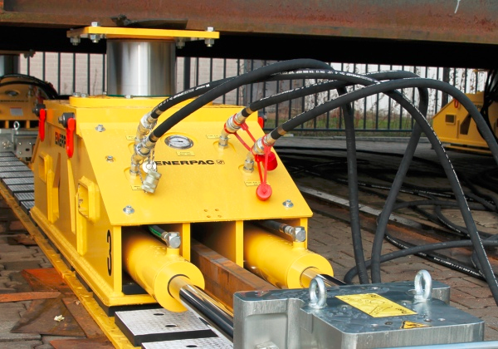
Force Control
Moving with a constant force given outside disturbance
Disturbance: sine wave = 0.02 * sin(ωt) m
Desired force: 30 N

Slide 6
Force Control

Slide 7
Force Control

Slide 8
Thank You

